Slide 1
Introduction of Code Coverage
(Using VCS)
Jerry Chang
2020/02/13

Slide 2
Outline
Code Coverage for VCS
  Coverage Types
  VCS Flow
  VCS Flow in csim_ASIC

Slide 3
Outline
Code Coverage for VCS
  Coverage Types
  VCS Flow
  VCS Flow in csim_ASIC

Slide 4
Coverage Type
According to the VCS coverage UG, it gives 5 kinds of coverage type
  Line Coverage
  Toggle Coverage
  Condition Coverage
  Branch Coverage
  FSM Coverage
Example A
Example B

Slide 5
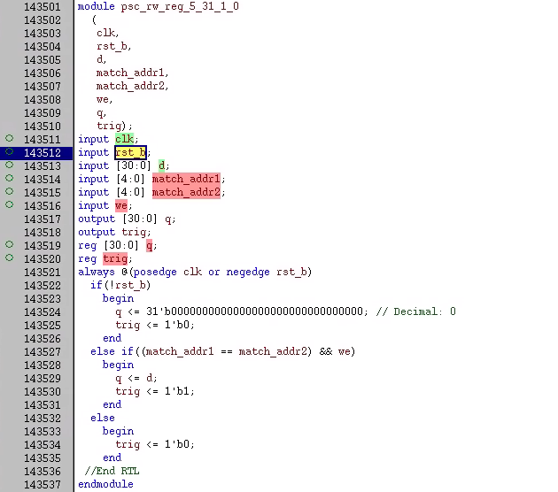
Example A

Slide 6
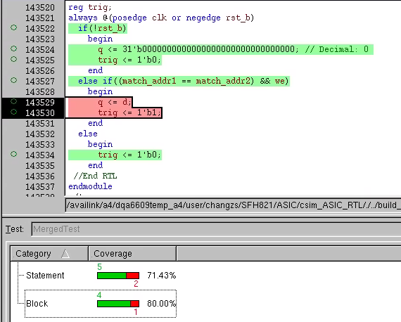
Line Coverage
Which line has been executed in always block
  Green →Executed
  Red→ Not executed
Line Coverage Rate (Statement) : 5/7 = 71.43%
Line Coverage Rate (Block) : 4/5 = 80.0%

Slide 7
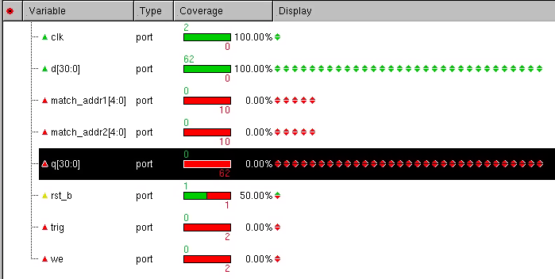
Toggle Coverage
Signal/Port (i.e., reg/wire/input/output …) transition
  Transitions, 0→1, 1→0
Toggle Coverage Rate: 65/152 = 42.76%

Slide 8
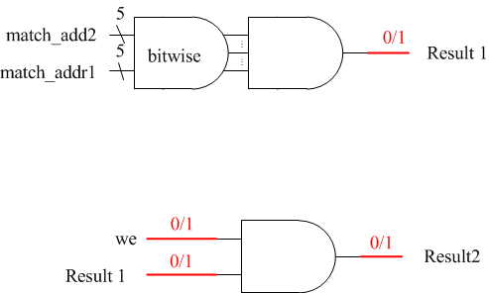
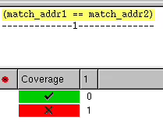
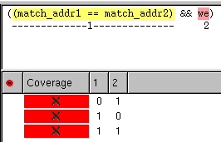
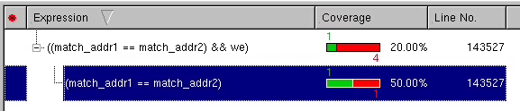
Condition Coverage
Condition in sub expression or expression are evaluated (0 and 1 are all evaluated).
Condition Coverage Rate: 1/5 = 20%

Slide 9
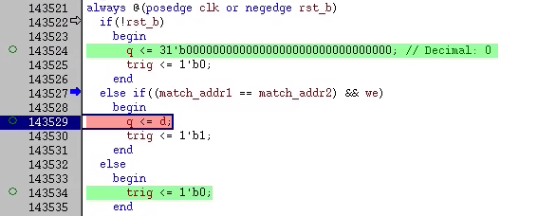
Branch Coverage
Coverage of expression and case statements (e.g., if..else/case/‘?’) that affect the control flow
Branch Coverage Rate = 1/3 = 33.3%

Slide 10
Coverage Type
According to the VCS coverage UG, it gives 5 kinds of coverage type
  Line Coverage
  Toggle Coverage
  Condition Coverage
  Branch Coverage
  FSM Coverage
Example A
Example B

Slide 11
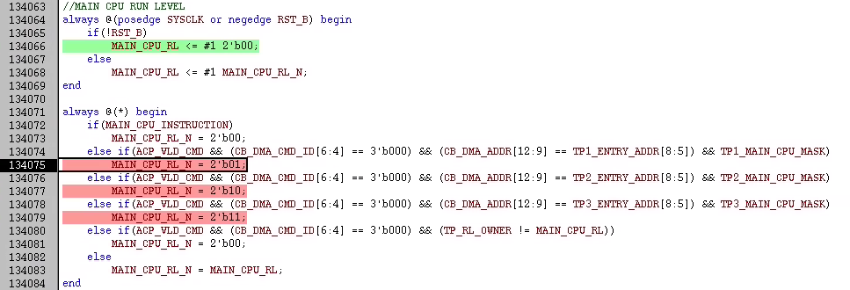
Example B
State Bit : 2, 4 states
Transition Paths : c₂⁴ = 12

Slide 12
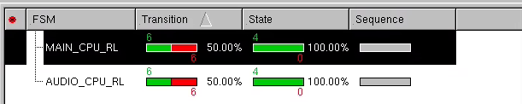
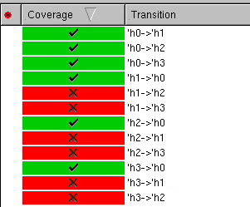
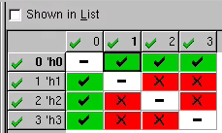
FSM Coverage
State: 2^2 = 4
Transition Paths : c⁴₂ = 12
FSM Coverage Rate = 6/12 = 50%

Slide 13
Outline
Code Coverage for VCS
  Coverage Types
  VCS Flow
    Compilation (vcs) & Simulation (simv)
    Converge Data Merge (urg)
    Debugging (dve or browser)
  VCS Flow in csim_ASIC

Slide 14
VCS Flow
Compilation & Simulation
–lca (limited custom available) => 啟動license的命令語句
–cm line+fsm+cond+branch+tgl+assert =>打開不同種類的coverage分析
–cm_dir “coverage_dir” =>存取coverage data的資料夾路徑
–cm_hier “coverage_hierachy” =>需要分析coverage的hierarchy
    Converge Data Merge (urg)
–dir => 需要merge的所有coverage 資料夾
–metric line+fsm+cond+branch+tgl => 指定輸出的coverage類型
–report => 指定輸出coverage report的路徑
–format => 指定輸出report的格式(html、text)
    Debugging (dve or browser)

Slide 15
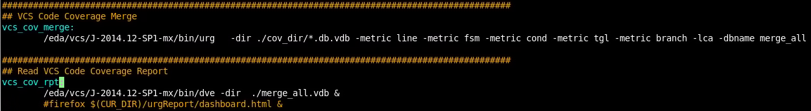
VCS Flow in csim_ASIC
make pattern_name run_options COV=ON
make vcs_cov_merge
make vcs_cov_rpt

Slide 16
